Slide 1
Network Discovery
a novel view for feature engineering

Slide 2
We focus on two things: finding cohesive regions of nodes and detecting relationships between those regions.

Slide 3
Transfer web traffic data into a network structure
The web traffic can be viewed as a network structure.
The web traffic can be viewed as a network structure. Each Wikipedia articles are organized into multiple homogeneous genres, which we can regard as regions, and complex interactions exist between articles within and across different regions, which we can regard as edges.

Slide 4
Concept of direct edge
According to the observation, page view of article A may have a cohesive change with the change of article C, which means their coefficient is positive.
However, this coherent maybe caused due to the relationship between AB and AC, which means the edge between A and C is not a direct connection.
Article A
Article B
Article C

Slide 5
Related Works
They are limited due to some reasons.
Edge Detection: GLasso
Assume that groups labels are known, which are not given in ground-truth data.
Clustering: K-Means, Spectral Clustering
Infer groups without considering edges or assume that edges are given.

Slide 6
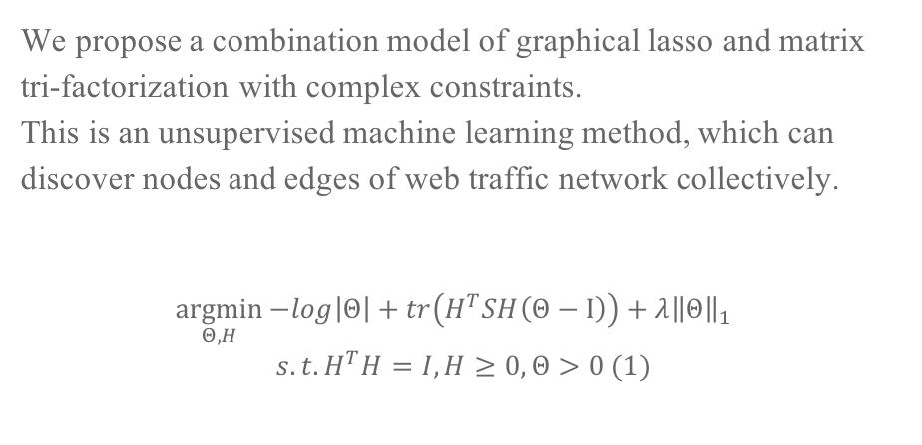
A new model for network discovery
We propose a combination model of graphical lasso and matrix tri-factorization with complex constraints.
This is an unsupervised machine learning method, which can discover nodes and edges of web traffic network collectively.
$$\underset{Θ, H}{argmin}{−log\left|Θ\right|}+tr\left(H^{T}SH\left(Θ−Ι\right)\right)+λ{\left\|Θ\right\|}_{1}$$
$$s.t. H^{T}H=I, H≥0, Θ>0 (1)$$

Slide 7
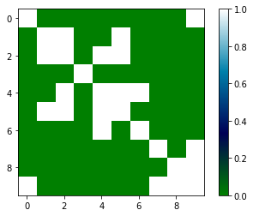
Real Precision Matrix of Toy Dataset

Slide 8
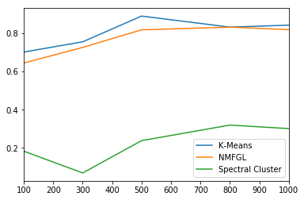
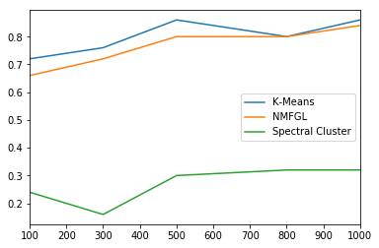
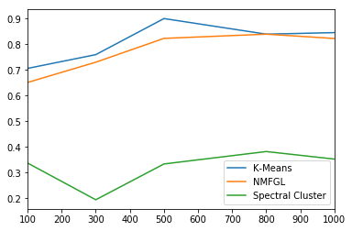
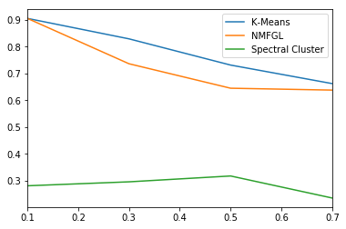
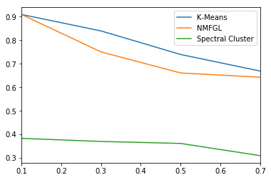
Comparison of Clustering
HomoScore on different sample size
PurityScore on different sample size
NmiScore on different sample size
HomoScore on different beta
PurityScore on different beta
NmiScore on different beta

Slide 9
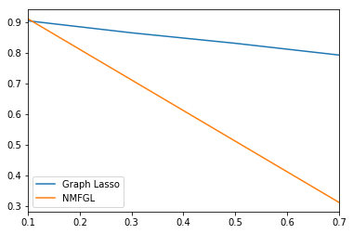
Comparison of Edge Detection
Edge Accuracy on different beta

Slide 10

145,063$×$551
Data downloaded from https://www.kaggle.com/c/web-traffic-time-series-forecasting

Slide 11
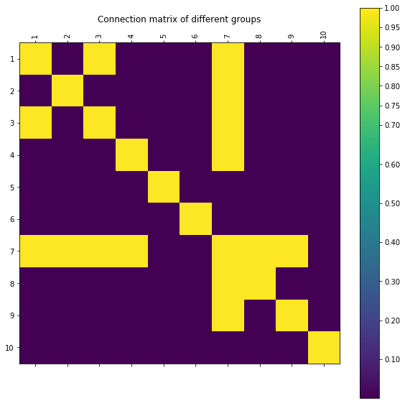
The Estimation of Precision Matrix

